Slide 1
SOFTWARE DEVELOPMENT PROJECT MANAGEMENT (CSC4125)
Lecture 5: Selection of an
Appropriate Project Approach

Slide 2
Lecture Outlines
Build or Buy
In-House/Outsourcing
Evaluate situations where software applications could be acquired off-the-shelf rather than being built specially
Taking account of the characteristics of the project
Select an appropriate process model
Waterfall
Spiral
Prototyping and iterative approaches
Incremental delivery
Agile approaches

Slide 3
Selection of Project Approaches
In-House development: most of these issues resolved by IS planning and standards
Software Houses/Suppliers: more applicable as different customers have different needs
Selection of approach governed by:
uncertainties of the project
properties of application to be built

Slide 4
In-House vs. SW Suppliers
In-House Software Development
Project team and users belong to same organization
Applications being considered slot into a portfolio of existing computer-based systems
Methodologies and technologies to be used are not selected by the project manager, but are dictated by local standards
Software Houses/Suppliers
Means that the developers and users of the software are in the different organization
Need for tailoring as different customers have different needs

Slide 5
Introduction
Where a series of development projects is being carried out by a software house for different external customers, the methodologies and technologies to be used will have to be decided for each individual project.
This decision-making is called ‘Project Analysis’ or, ‘Technical Planning’ or methods engineering or methods tailoring

Slide 6
Introduction
Different types of projects need different types of approach.
If you are working in one particular environment which specializes in one type of software, then the approach is likely not to change much from one project to another.
If you work for different clients in different organizations developing a variety of applications then the approach for each project may need to be tailored.

Slide 7
Build or Buy?
In-House development?
Outsource?
Either
Build
Buy

Slide 8
In-House SW Development
Developing a new IT application in-House:
Time is needed to develop the software
Would often require the recruitment of new technical staff to do the job
Usually, the new staff won’t be needed after the project is completed
Sometimes due to the novelty of the project, there may be lack of executives to lead the effort

Slide 9
Outsourcing
Contracting the project out to an external IT development company (Outsourcing):
Time is needed to develop the software
The conducting company will have technical and project expertise not readily available to the client
The client would still do management effort to establish and manage the contracts
Note: whether in-house or outsourced, software development is still involved

Slide 10
Developing a SW using OTS components
Instead of developing a software component from scratch, organizations occasionally purchase off-the-shelf (OTS) components from third-party vendors and integrate them with their own components.
A major issue that can arise while integrating different components is mismatches among code pieces developed by different parties usually unaware of each other.
OTS components produced by the vendor organizations are known as commercial off-the-shelf (COTS) components.

Slide 11
Advantages of Off-The-Shelf (OTS) software
Cheaper as supplier can spread development costs over a large number of customers
Development time is reduced. Software already exists
Can be examined and trialed by potential customer
No delay while the software is being developed
More reliable because the SW is well-debugged and well-proven
where lots of people have already used the software, most of the bugs are likely to have been reported and removed

Slide 12
Disadvantages of Off-The-Shelf (OTS) software
Customer will have same application as everyone else: no competitive advantage, but competitive advantage may come from the way application is used.
Customer may need to change the way they work in order to fit OTS application.
Dependence on vendor– the vendor controls it development
Customer does not own the code and cannot change it
Danger of over-reliance on a single supplier
Stability of the vendor –Vendors can go out of business, can be purchased by other companies or completely drop support for a product

Slide 13
Choosing Technologies
Technologies might include an appropriate application-building environment, or the use of knowledge-based system tools.
Technology will influence
Training requirements for development staff
Types of staff to be recruited
Development environment – hardware and software
System maintenance arrangements

Slide 14
Steps of Project Analysis
Identify project as objectives-driven or product-driven
Analyze other project characteristics
Identify High-Level Project Risks
Take into account user requirements concerning implementation
Select General Life-Cycle Approach

Slide 15
Steps of Project Analysis (cont.)
Identify project as objectives-driven or product-driven
A product-driven project creates products defined before the start of the project
An objective-driven project will often have come first which will have defined the general software solution that is going to be implemented

Slide 16
Steps of Project Analysis (cont.)
Analyze other project characteristics
Is a data-oriented or process-oriented system to be implemented?
Will the software that is to be produced be a general tool or application-specific?
Are there specific tools available for implementing the particular type of application?
Does it involve concurrent processing?
Will the system to be created knowledge-based?
Will the system to be produced make heavy use of computer graphics?
Is the system to be created safety critical?
Is the system designed to carry out predefined services or to be engaging and entertaining?
What is the nature of the hardware/software environment in which the system will operate?

Slide 17
Steps of Project Analysis (cont.)
Identify High-Level Project Risks
The greater the uncertainties at the beginning, the greater the risk that the project will be unsuccessful.
Recognizing the area of uncertainty allows taking steps towards reducing its uncertainty.
Uncertainty can be associated with products, processes, or resources of a project.
Product Uncertainty
Process Uncertainty
Resource Uncertainty

Slide 18
Identify High-Level Project Risks (cont.)
Product Uncertainty
How well are the requirements understood?
The users themselves could be uncertain about what the system is to do.
Process Uncertainty
The project under consideration might the first where an organization is using an approach like XP or a new application-building tool
Resource Uncertainty
Main area of resource uncertainty is the availability of the staff with the right ability and experience

Slide 19
Steps of Project Analysis (cont.)
Take into account user requirements concerning implementation
A client organization often lays down standards that have to be adopted by any contractor providing software for them
Sometimes client organizations specify that suppliers of software have certain accreditation
Tool/Technology Constraints
Methodology Constraints
Other Constraints

Slide 20
Steps of Project Analysis (cont.)
Select General Life-Cycle Approach
Look at risks and uncertainties, e.g.
Are requirements well understood?
Are technologies to be used well understood?
Look at the type of application being built, e.g.
Embedded System?
Information Systems?
General Application?
Specialized Techniques?
Hardware Environment?
Safety-Critical System?
Imprecise Requirements?
Differences between target and development environments?

Slide 21
Choice of Process Models
The word ‘process’ emphasizes the idea of a system in action.
In order to achieve an outcome, the system will have to execute one or more activities –this is its process. This applies to the development of computer-based applications.
A number of interrelated activities have to be undertaken to create a final product. These activities can be organized in different ways and we can call these process models.

Slide 22
Structure versus Speed of Delivery
Structured approach
Also called ‘heavyweight’ approaches (Because of additional effort needed and their greater applicability to large and complex projects)
Step-by-step methods where each step and intermediate product is
carefully defined
The pay-off is less error prone and more maintainable final system
Emphasis on getting quality right first time
Example: use of UML and USDP
Future vision: Model-Driven Architecture (MDA). UML supplemented
with Object Constraint Language (OCL), press the button and application code generated from the UML/OCL model

Slide 23
Structure versus Speed of Delivery
Agile methods
Emphasis on speed of delivery rather than documentation
XP, SCRUM, DSDM, etc.
RAD (Rapid application development ) emphasized use of
quickly developed prototypes of the software for users to evaluate
JAD (Joint application development) – Requirements are
identified and agreed in intensive workshops with users
Another way of speeding up delivery is simply to deliver less.
This can be done by breaking a large development into a series of small increments, each of which delivers a small amount of useful functionality quickly.

Slide 24
Software Process Models
Waterfall Model
V-process Model
Spiral Model
Software Prototyping
Phased Development Model
Incremental development model
Iterative development model
Agile Models –XP, SCRUM etc.

Slide 25
The Waterfall Model
Classical model of system development
Also known as ‘one-shot’, or, ‘once-through’ model
Limited scope of iteration. Is this a strength or a limitation??
This is a strength for WF model
Because it is suitable for some projects especially for large projects, we want to avoid reworking tasks that are thought to be completed
Suitable for systems with well defined requirements
Not suitable for systems of high uncertainty

Slide 26
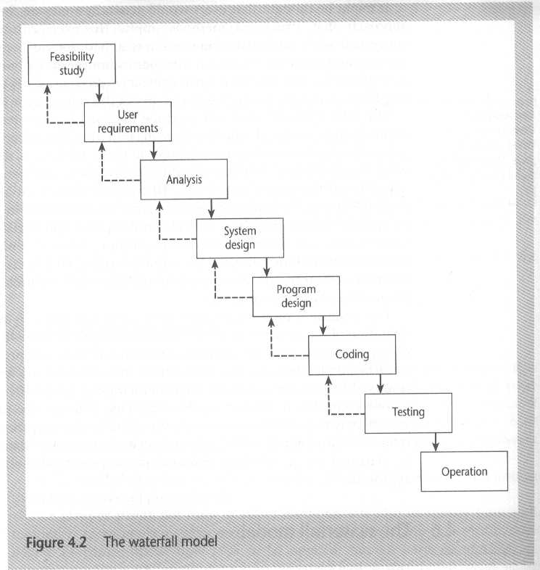
The Waterfall Model

Slide 27
The V-Process Model
An extension of the Waterfall model
The V-process model can be seen as expanding the activity box ‘testing’ in the Waterfall model
Each step has a matching validation process which can, where defects are found, cause a loop back to the corresponding development stage and a reworking of the following steps.
Stresses the necessity for validation activities that match the activities creating the products of the project.

Slide 28
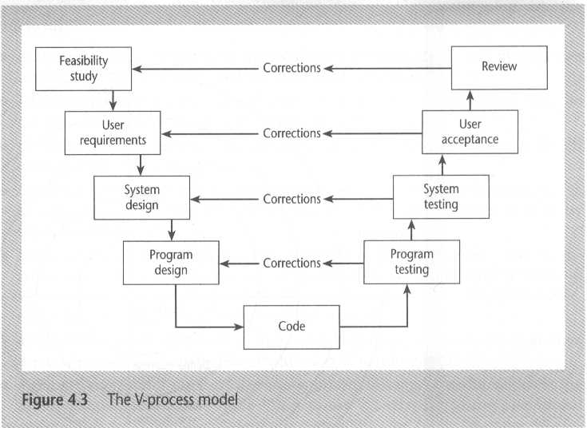
The V-Process Model
Another way of looking at the Waterfall model

Slide 29
The Spiral Model
A greater level of detail is considered at each stage of the project and a greater degree of confidence about the probability of success for the project should be justified.
Represented as a loop or a spiral where the system is considered in more detail.
Each sweep is terminated by an evaluation before the next iteration is embarked upon.
Can be characterized by repeatedly iterating a set of elemental development processes and eliminating risk, so it is actively being reduced.
In each phase/loop, risks are analyzed rigorously and resolved.

Slide 30
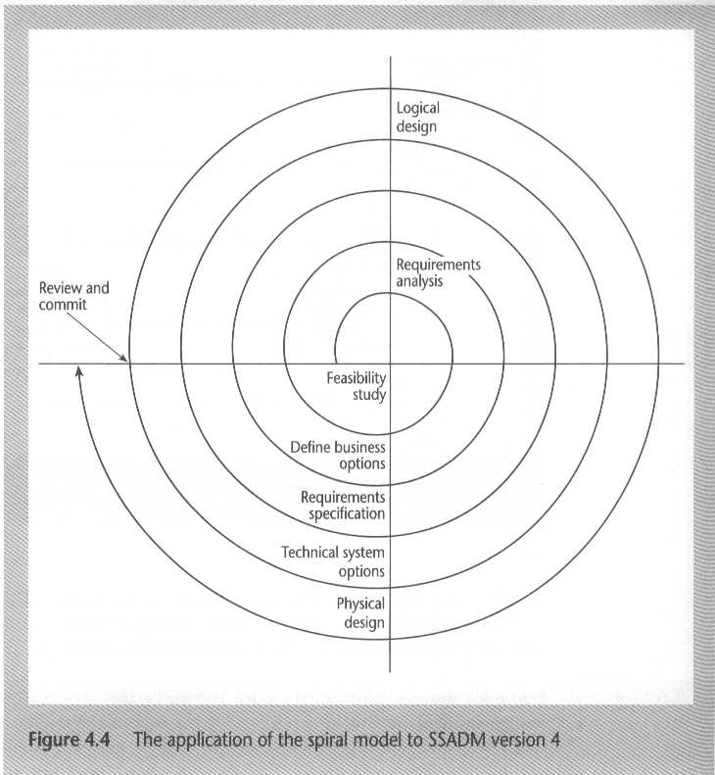
The Spiral Model
Figure 4.3 @ page 85 ( 5th edition)

Slide 31
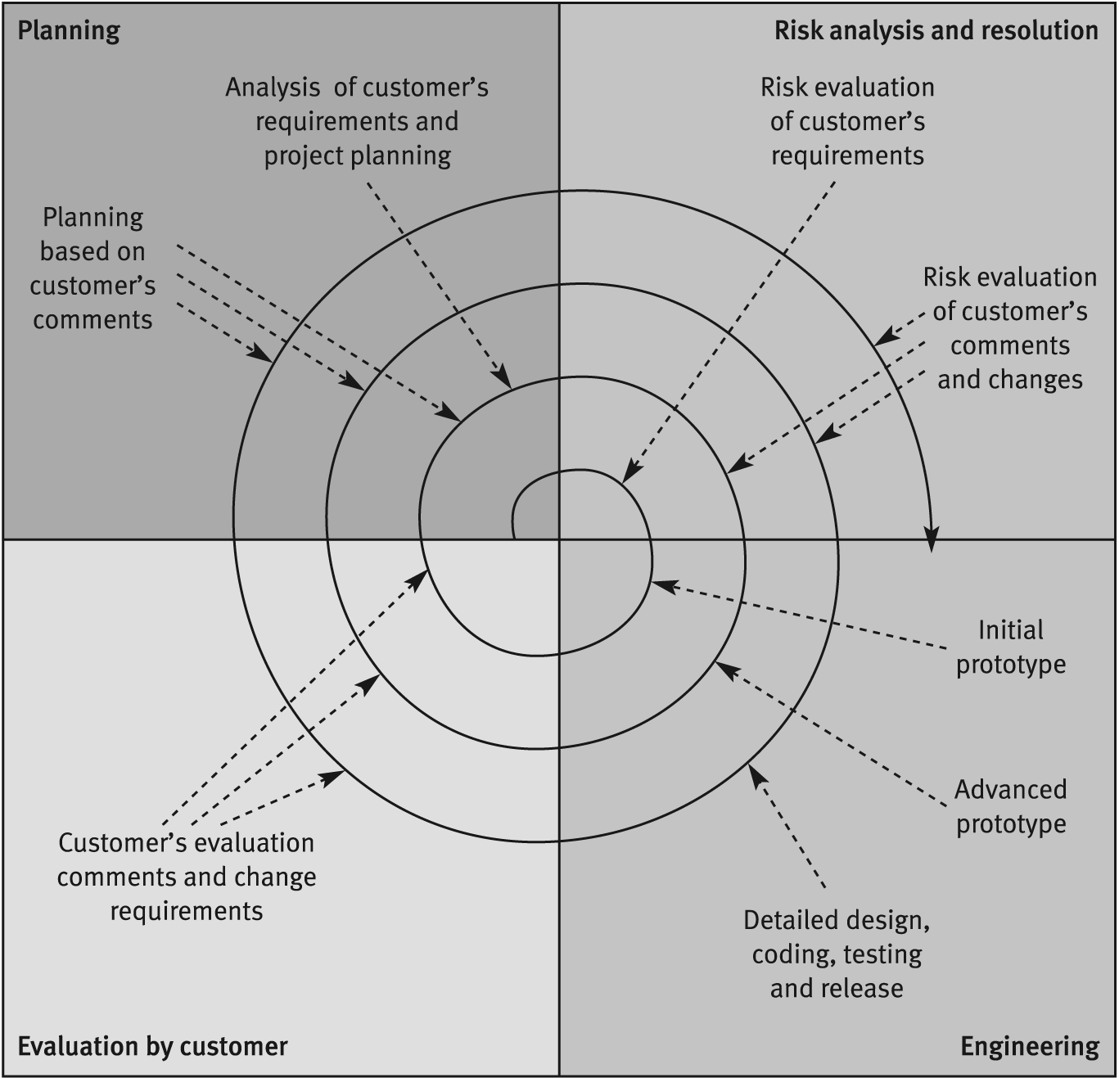
Another view of The Spiral Model

Slide 32
Software Prototyping
A prototype is a working model of one or more aspects of the projected system. It is constructed and tested quickly and inexpensively in order to test out some assumptions.
Prototyping may be able to reduce project uncertainties by allowing knowledge to be bought through experimentation.
Goal
Gain knowledge
Reduce risk and uncertainty
Verify a design or implementation approach

Slide 33
Classification of Prototypes
Throw-Away Prototypes
Tests out some ideas
Discarded when the true development of the operational system is started
The prototype could be developed using a different SW and HW environment than those that will be used for the final system
Example : User Interface
Prototype: use a desktop application builder to produce an acceptable user interface
Final system: use a procedural programming language

Slide 34
Classification of Prototypes(cont.)
Evolutionary Prototypes
The prototype is developed and modified until it is finally in a state where it can become the operational system
The standards that are used to develop the software have to be carefully considered

Slide 35
Prototyping: Advantages
Learning by doing
Improved communication
Improved user involvement
Clarification of partially-known requirements
Demonstration of consistency and completeness of a specification
Reduced need for documentation
Reduced maintenance costs
Feature constraint
Production of expected results

Slide 36
Prototyping: Drawbacks
Users can misunderstand the role of the prototype
Lack of project standards possible
Lack of control
Additional expense
Machine efficiency
Close proximity of developers

Slide 37
Prototypes at Different Stages
Different projects will have uncertainties at different stages
Thus, prototypes can be used at different stages
Examples:
At the requirements gathering stage: to pin down requirements that seem blurred and shifting
At the design stage: to test out the user’s ability to navigate through a sequence of input screens

Slide 38
Other Ways of Categorizing Prototypes
What is being learnt?
Specify what you hope to learn
Plan how the prototype is to be evaluated
Report on what has actually been learnt
To what extent is the prototyping to be done?
Mock-ups
Simulated interaction
Partial working model
Vertical –only some features are fully prototyped
Horizontal –all features are prototyped but not in detail
What is being prototyped?
Human-computer interface
Functionality of the system

Slide 39
Controlling Changes During Prototyping
A major problem with prototyping is controlling changes to the prototype following suggestions by the users.
Categories of Changes –
Cosmetic
Local
Global

Slide 40
Controlling Changes During Prototyping
Categories of Changes:
Cosmetic (about 35%) – These are simple changes to the layout of screens/reports. They are:
Implemented
Recorded
Local (about 60%) –These change the way that a screen/report is processed but do not affect other parts of the system. They are:
Implemented
Recorded
Backed-up so that they can be removed at a later stage if necessary
Inspected retrospectively
3) Global (about 5%)–These are changes that affect more than one part of the processing.
All changes here have to be the subject to a design review before they can be implemented

Slide 41
Incremental delivery
The application to be delivered is broken down into a number of components each of which will be actually used by the users. Each of these is then developed as a separate ‘mini-project’ or increment.
Break the system into small components
Implement and deliver small components in sequence
Every delivered component provides extra functionality to the user
Time-boxing is often associated with an incremental approach.

Slide 42
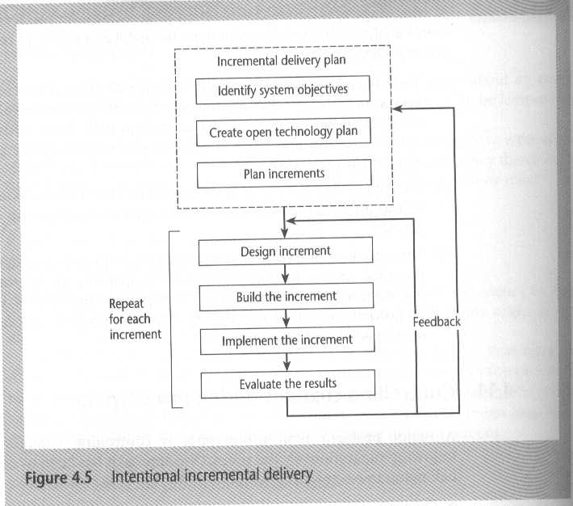
Incremental delivery
Figure 4.4 @ page 89 (5th edition)

Slide 43
Incremental Development: Advantages
Feedback from early increments improves the later stages
Possibility of changes in requirements is reduced because of the shorter time span between the design of a component and its delivery
Users get benefits earlier than with a conventional approach
Early delivery of some useful components improves cash flow, because you get some return on investment early on
Smaller sub-projects are easier to control and manage
‘Gold-plating’ , that is the requesting of features that are unnecessary and not in fact used, is less
The project can be temporarily stopped if more urgent work emerges
Job satisfaction is increased for developers who see their labor bearing fruit at regular and short intervals

Slide 44
Incremental Development : Disadvantages
‘Software breakage’, that is, later increments might require the earlier increments to be modified.
Programmers may be more productive working on one large system than on a series of smaller ones.
Loss of economy of scale – some costs will be repeated.

Slide 45
Incremental Development Initial Steps
Incremental Delivery Plan
Identify System Objectives
Functional Goals
Quality Characteristics
Create Open Technology Plan
Standard High-Level Language
Standard Operating System
Small Modules
Variable Parameters
Standard Database Management System

Slide 46
Incremental Development Initial Steps
Plan Increments
Steps typically should consist of 1% to 5% of the total project
Non-computer steps should be included
An increment should typically take between 1 to 3 months
Each increment should deliver some benefit to the user
Some increments will be physically dependent on others
Value-to-Cost ratios may be used to decide priorities

Slide 47
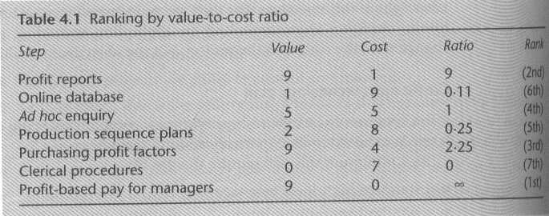
Value-to-Cost Ratio Ranking

Slide 48
Iterative Model
Deliver full system in the beginning.
Enhance existing functionality in new releases.
Design system
Version n
NO
n = n + 1
System
Complete?
Develop system
Version n
Validate system
Version n
YES

Slide 49
Combined Incremental and Iterative Model
Every new release include:
Extra functionality
Enhancement of existing functionality
Popularly used in software industry.

Slide 50
Dynamic Systems Development Method
Dynamic Systems Development Method ➔DSDM
UK-based consortium
arguably DSDM can be seen as replacement for SSADM
SSADM is ‘Structured Systems Analysis and Design Method’ a very heavy-weight and bureaucratic methodology that was promoted by the UK government
DSDM is more a project management approach than a development approach

Slide 51
Nine core DSDM Principles
Active user involvement is imperative
DSDM teams must be empowered to make decisions
Focus on frequent delivery of products
Fitness for business purpose is the essential criterion for acceptance of deliverables
Iterative and incremental delivery is necessary to converge on an accurate business solution
All changes during development are reversible
Requirements are base-lined at a high-level
Testing is integrated throughout the life-cycle
A collaborative and cooperative approach between all stakeholders is essential

Slide 52
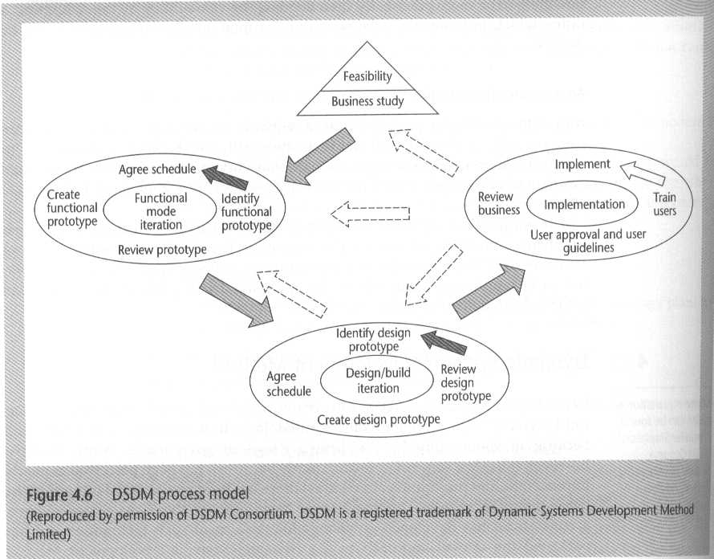
DSDM Process Model

Slide 53
DSDM: time-boxing
Time-box: fixed deadline by which something has to be delivered
Typically two to six weeks
Relative importance of requirements can be categorized using the ‘MoSCoW’ classification.
In order to make the delivered package coherent and as useful as possible to the users, requirements are prioritized according to the MoSCoW rules

Slide 54
‘MoSCoW’ Requirements Classification
‘MoSCoW’ priorities:
Must have: essential features
Should have: these would probably be mandatory if you were using a conventional development approach, but the system can operate without them
Very important, but system could operate without
Could have: these requirements can be delayed with some inconvenience
These are desirable but not necessary, and could improve user experience or customer satisfaction for little development cost.
These will typically be included if time and resources permit.
Won’t have: these features are wanted, but their delay to a later increment is readily accepted
WON'T requirements are either dropped or reconsidered for inclusion in later time-boxes
Want - but probably won’t get!

Slide 55
Extreme Programming
A further development of RAD and DSDM principles
Increments of working software (1 to 3 weeks)
Customer can suggest improvement at any point
Customer can suggest improvements at any stage
Code should be developed to meet existing requirements and not for future uncertain extensions
Frequent redesigns (refactoring) of code
Developers work in pairs
Test cases and expected results are devised before design
Test cases are consolidated after each increment
Consolidated test cases are run after each new increment

Slide 56
Grady Booch’s concern
Grady Booch, an OO authority, is concerned that with requirements driven projects:
‘Conceptual integrity sometimes suffers because this is little motivation to deal with scalability, extensibility, portability, or reusability beyond what any vague requirement might imply’
➔Tendency towards a large number of discrete functions with little common infrastructure
Booch suggests there are two levels of development:
Macro process
Micro process

Slide 57
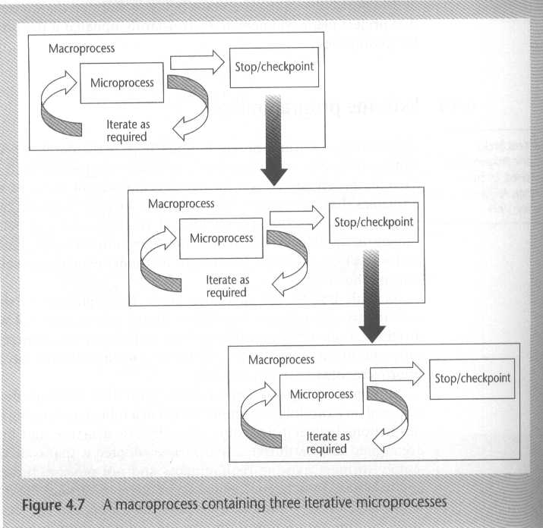
Macro process and Micro process
A macro process containing three iterative micro processes

Slide 58
Selecting the most appropriate process model: ‘Rules of thumb’ about Approach to be used
IF uncertainty is high
THEN use evolutionary approach
IF complexity is high but uncertainty is not
THEN use incremental approach
IF uncertainty and complexity both low
THEN use one-shot
IF deadline (schedule) is tight
THEN use evolutionary/incremental

